Slide 1
M3-MIFARE DESFire Training
MIFARE DESFire EV1 Introduction
Abu Ismail, BUID CAS
MIFARE DESFire EV1
Standard Product Training
2013

Slide 2
Content
MIFARE DESFire Evolutions
MIFARE DESFire EV1 Introduction
MIFARE DESFire EV1 Positioning
MIFARE DESFire EV1 Implementation in SmartMx
MIFARE DESFire EV1 Licensing
MIFARE DESFire EV1 Convergence
MIFARE DESFire EV1 Installations example
M302_MIFARE DESFire Training - MIFARE DESFire EV1 Introduction_AIv13.01.ppt

Slide 3
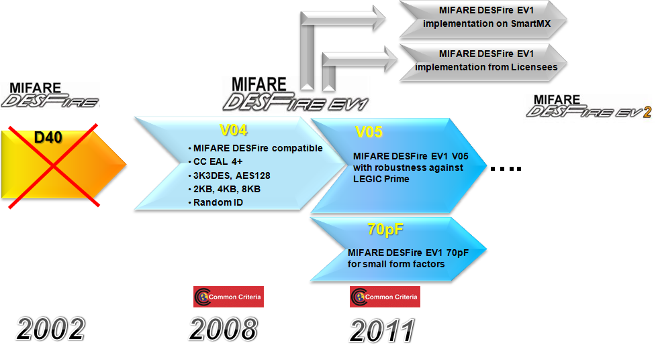
MIFARE DESFire platform evolution
TDES Native Mode
16-byte TDES Key
Only 4Kbytes EEPROM
CRC16, MAC
M302_MIFARE DESFire Training - MIFARE DESFire EV1 Introduction_AIv13.01.ppt

Slide 4
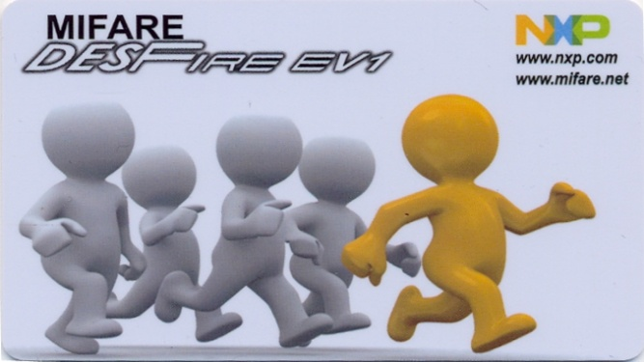
MIFARE DESFire EV1 CPU and OS
Asynchronous CPU core
TDES co-processors
AES co-processor
Fixed command set with a lot of commands for applications
No Customer ROM codes
MIFARE DESFire EV1
”Buy the card and use it.“
On shelf product
CPU
EEPROM
TDES Coprocessors.
AES Coprocessor
RF-Interface
M302_MIFARE DESFire Training - MIFARE DESFire EV1 Introduction_AIv13.01.ppt

Slide 5

MIFARE DESFire EV1 interface
Contactless only, ISO/IEC 14443 part 2, Type A
Fully compliant to the ISO/IEC14443A, all the parts (1-4)
Any standard ISO/IEC 14443 reader can be used to communicate with MIFARE DESFire EV1
7 bytes UID (“Double Size UID”), optional random ID
MIFARE DESFire EV1
Operating distance up to 10 cm, based on card coil design and power supplied by the coupling device
Data transmission: 106, 212, 424 and 848 kbps
CPU
EEPROM
Crypto Coprocessors
RF-Interface
M302_MIFARE DESFire Training - MIFARE DESFire EV1 Introduction_AIv13.01.ppt

Slide 6
MIFARE DESFire EV1 file system
NV Memory:
  EEPROM: 8 Kbytes, 4 Kbytes or 2 Kbytes
  Erase + Write access: 2.7 ms (each 64-byte)
  R/W-Cycles: Typical 500 000
  Data retention: 10 years
File System:
  up to 28 application in a card
  up to 32 files per application
  up to 14 keys, “free” and “never” access per application
  1 master key for card maintenance
  Plain, encrypted, or MACed (CMACed) data transmission
  On-Chip Backup management
M302_MIFARE DESFire Training - MIFARE DESFire EV1 Introduction_AIv13.01.ppt

Slide 7

MIFARE DESFire EV1 implementation in SmartMx
MIFARE DESFire EV1 implementation is available on both SmartMX(P5CD081 family) and JCOPvx.x.x
Available Platform
  SmartMX(HW) : P5CD081/41/21/16, P5CN081
  JCOPvx.x.x(J3C081)
Available Product Configurations
  MIFARE DESFire EV1 8K : P5CD081/41, P5CN081, J3C081
  MIFARE DESFire EV1 4K : P5CD081/41/21/16 , P5CN081
  MIFARE DESFire EV1 2K : P5CD081/41/21/16 , P5CN081
x.x.x = For JCOP version, contact your local NXP.
P60 is coming with option for both MIFARE Plus and MIFARE DESFire EV1
Can be part of the NXP eSE in NFC device
M302_MIFARE DESFire Training - MIFARE DESFire EV1 Introduction_AIv13.01.ppt

Slide 8





MIFARE™ technology licensing
MIFARE is an open architecture platform for secure and flexible end to end solutions.
NXP is committed to license the MIFARE family to a sufficient number of IC vendors to serve the needs of the contactless MIFARE & NFC ecosystem. A wide range of products from NXP and licensed partners are available.
License agreements with Renesas, ST-Microelectronics and Legic is an important step forward in that direction:
  Includes MIFARE Classic, MIFARE Plus and MIFARE DESFire
  Application fields include Banking, SIM and embedded secure elements
MIFARE DESFire licensing agreement with Gemalto to produce MIFARE DESFire SIM cards on any of their chip vendors
M302_MIFARE DESFire Training - MIFARE DESFire EV1 Introduction_AIv13.01.ppt

Slide 9



Convergence payment + transit
MIFARE DESFire EV1 on SmartMX (P5CD081) family
One chip solution enables customers efficient and small foot print solution for multi application cards to support the convergence of transportation, contactless payment as well as physical/logical access application
DESFire implementation are available on both P5CD081 family (HW) and JCOP V2.4.2 with fully compatibility to MIFARE DESFire EV1
Best solution to Banks or Brands (VISA/MCW) to increase number of end users with reasonable cost increase of convergence card
Ideal offering for corporate enterprise customers for best in class converged physical & logical access solution
UserOS has possibility to access MIFARE DESFire memory
(i.e. for data initialization purpose)
M302_MIFARE DESFire Training - MIFARE DESFire EV1 Introduction_AIv13.01.ppt

Slide 10
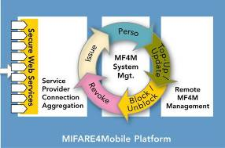
MIFARE™ based NFC ecosystems
NXP has released the MIFARE4Mobile* API specification
NXP form industry group to further develop the specification (group member incl. Gemalto, G&D, OCS, Vivotech, etc)
Addressing interoperability issues when
managing MIFARE resources in NFC Secure Element
Easing interactions between the stakeholders
of complex NFC ecosystems
NXP will license M4M IP on a royalty-free basis
  In conjunction with licensed MIFARE SIM IC or embedded Secure Element
  Interoperability tests with low-hurdle self-certification
* Secure end-to-end method for managing multiple MIFARE cards and applications in the Secure Element of an NFC handset
M302_MIFARE DESFire Training - MIFARE DESFire EV1 Introduction_AIv13.01.ppt

Slide 11
MIFAE DESFire EV1 example system architecture
Backend
Application
Application Interface
Depends on crypto library and architecture with SAM (X or classical).
MIFARE DESFire EV1 library
Crypto Abstraction Layer
Or
SAM library
Crypto library
Key
storage
We strongly
recommend to use
MIFARE SAM AV2
ISO 7816 stack
ISO 14443 - 4
ISO 14443 - 3
ISO 14443 - 2
SAM
MIFARE DESFire
M302_MIFARE DESFire Training - MIFARE DESFire EV1 Introduction_AIv13.01.ppt

Slide 12

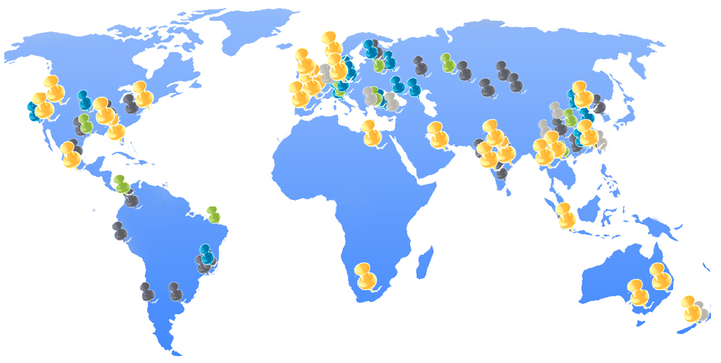
Some of MIFARE DESFire AFC installations
Running with MIFARE DESFire (EV1) , 2011
Countrywide UK, ES, FI, CZ, IN, NZ, UAE, VN, TH, CO.
Seattle, San Francesco, Cairo, Sydney, Melbourne, Adelade, Nanjing.
M302_MIFARE DESFire Training - MIFARE DESFire EV1 Introduction_AIv13.01.ppt

Slide 13
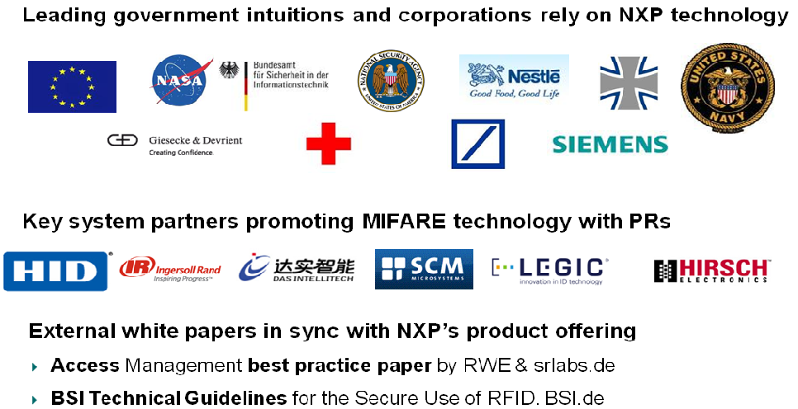
Some of MIFARE DESFire AC installations
M302_MIFARE DESFire Training - MIFARE DESFire EV1 Introduction_AIv13.01.ppt

Slide 14
Thank you very much.
We appreciate your feedback.
Abu Ismail
Senior Engineer, Customer Application Support
Business Unit Identification
NXP Semiconductors Germany GmbH
Stresemannallee 101, 22529 Hamburg, Germany
Tel: +49(0)40 5613 5070, Mob:+49(0)15115210535, Fax:+49(0)40561365070
abu.ismail@nxp.com, http://www.nxp.com, http://www.mifare.net
M302_MIFARE DESFire Training - MIFARE DESFire EV1 Introduction_AIv13.01.ppt

